Slide 1

TEA FACTORY MANAGEMENT SYSTEM
GROUP No. 16
COSC 12043

Slide 2
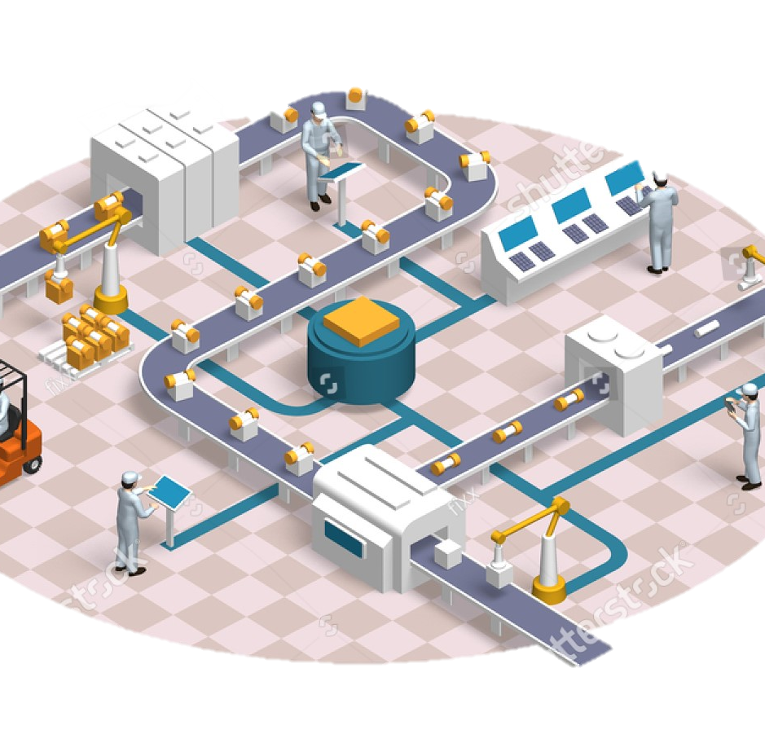
OBJECTIVE
Developing an OOP-based system for a tea factory to use as a tool to ease the management of the tea factory.

Slide 3
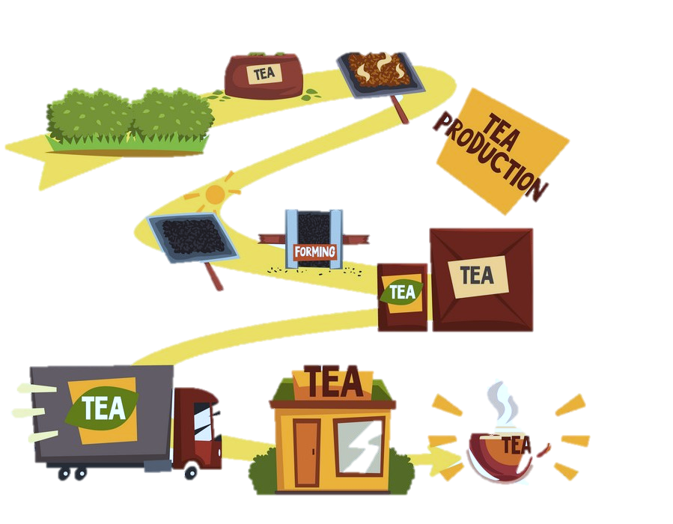
Why we chose a tea factory for our project?
the management procedure of both human resources and other materialized resources of a tea factory is not an easy task with the traditional manual techniques.
Because, large number of employees, tea estates, suppliers, sellers and other types of numerous numbers of things are involving in this whole procedure.

Slide 4

Why we used OOP ?
Many concepts of Object-oriented programming such as,
Inheritance
Polymorphism
Abstraction
Encapsulation
are helped us to fulfil the requirements of our tea factory management system.

Slide 5
Classes
Tea Factory Management System
Employee
Market
Finance
Product
Suppliers
Property

Slide 6

Finance Class
total_salary_of_ manager()
total_salary_of_all_ laborers()
Finance
total_salary_of_all_ superintendents()
total_production_ cost()
net_income_of_the _ poduction()

Slide 7

Finance Class
We use this class to analyze all financial information.
We can use a “private” class of preventing access from the outside of the class.
The major outcome of this class is to get a clear idea of net income.
OOP Concepts and the Modifications of Employee class

Slide 8

Employee Class
Employee
Labor
Manager
Factory Labor
Estate Labor

Slide 9
OOP Concepts and the Modifications of Employee class
to ease the management task of the information related to the human resources of the factory.
Usage of the concept of Abstraction for the Employee class.
All the data fields of the Employee class are “private” to prevent access from the outside of the class.
Uses of the ArrayList class in the Manager class to collect labor information.- uses of add() and remove() methods.

Slide 10

Market Class
marketOfProducts
localMarket
foreignMarket

Slide 11
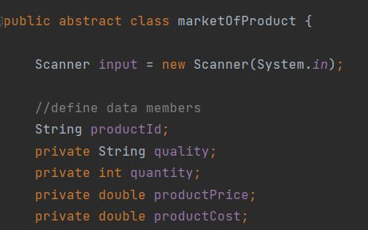
Purpose :
To get information about behave of each product in the market within a particular time period.
Encapsulation
Abstraction concepts

Slide 12
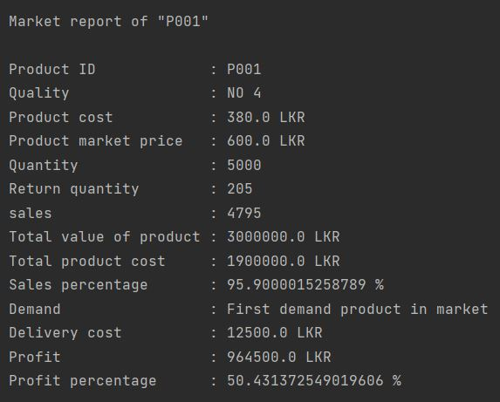
Outcomes
* sales of the product and percentage
* delivery cost
* demand of the product in the market
* total product cost
* total value of the product issued to the market
* profit or loss of the product and the percentage
* final report
By referring final report company can make decisions
on each product

Slide 13

Suppliers Class
Supplier
teaLeavesSupplier
fertilizerSupplier
ingredientSupplier

Slide 14
Purpose
Manage the suppliers who supply materials to the company.
Outcomes
* get all details about each supplier
* find all suppliers according to the materials they supply
* place an order to the supplier
* payment to be done for the order
* ordered date
* ordered quantity
* check whether any previous orders placed to the suppliers
Find method
According to the budget, the company can decide which supplier(s) will be given the order.

Slide 15

Product Class
Age
Cost
Product
Product code
Product benefit
Total Cost

Slide 16
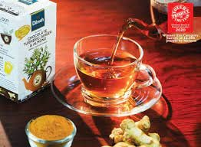
OOP Concepts and the Modifications of product class
Product class helps you select a product code that you can buy money on your hand and suitable for your age and inform you about product benefits.
We created 5 methods. They are age , cost , product code , product benefits , total cost
Product class helps to calculate your total cost.
Product class use the OOP concept like an inheritance.
Product class have loops , if else statement, switch statements

Slide 17
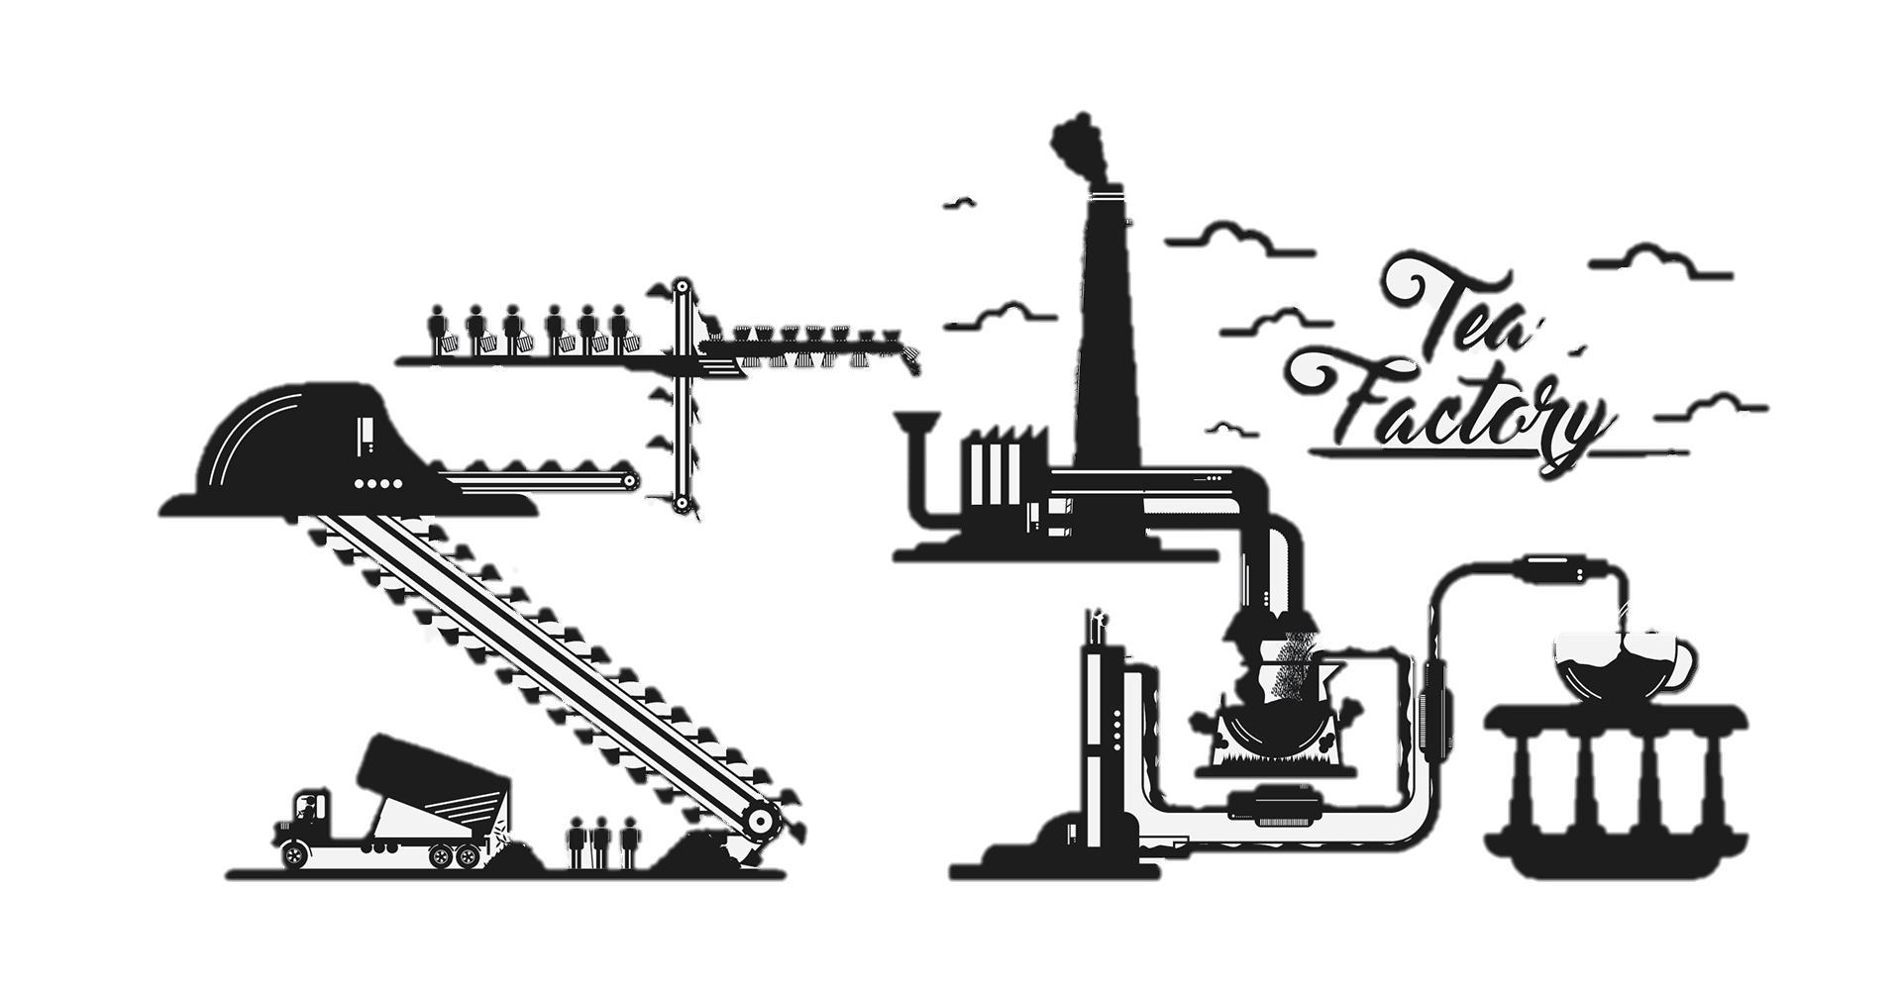
Property Class
Property
Machines
Lands

Slide 18

Challengers and Solutions
Compilation errors
Mismatches and errors while collecting all source files together

Slide 19
Teamwork
PS/2019/154 SAMARASINGHE W.L.A.W.B. (Team Leader) developing Finance class
PS/2019/036
GANEPOLA G.A.D.D. developing Market class
PS/2019/060
SANDEEPANI B.L.S. developing property class
PS/2019/259 WEERASINGHE S.A. developing employee class
PS/2019/092
COSTHA W.D.A.C.H. developing of product class
With the contribution of all members - developing of supplier class

